Slide 1
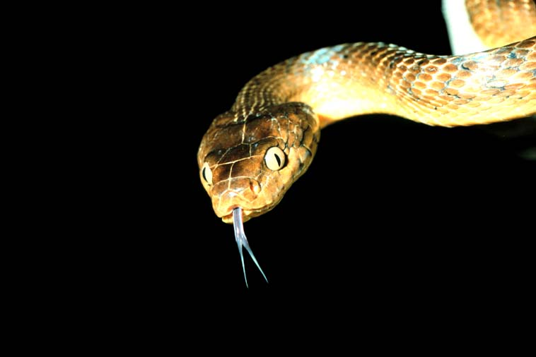
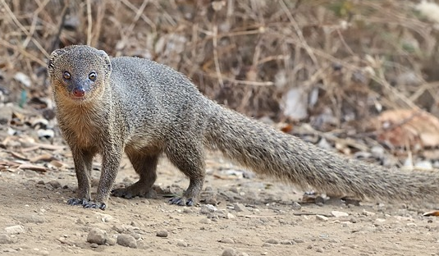
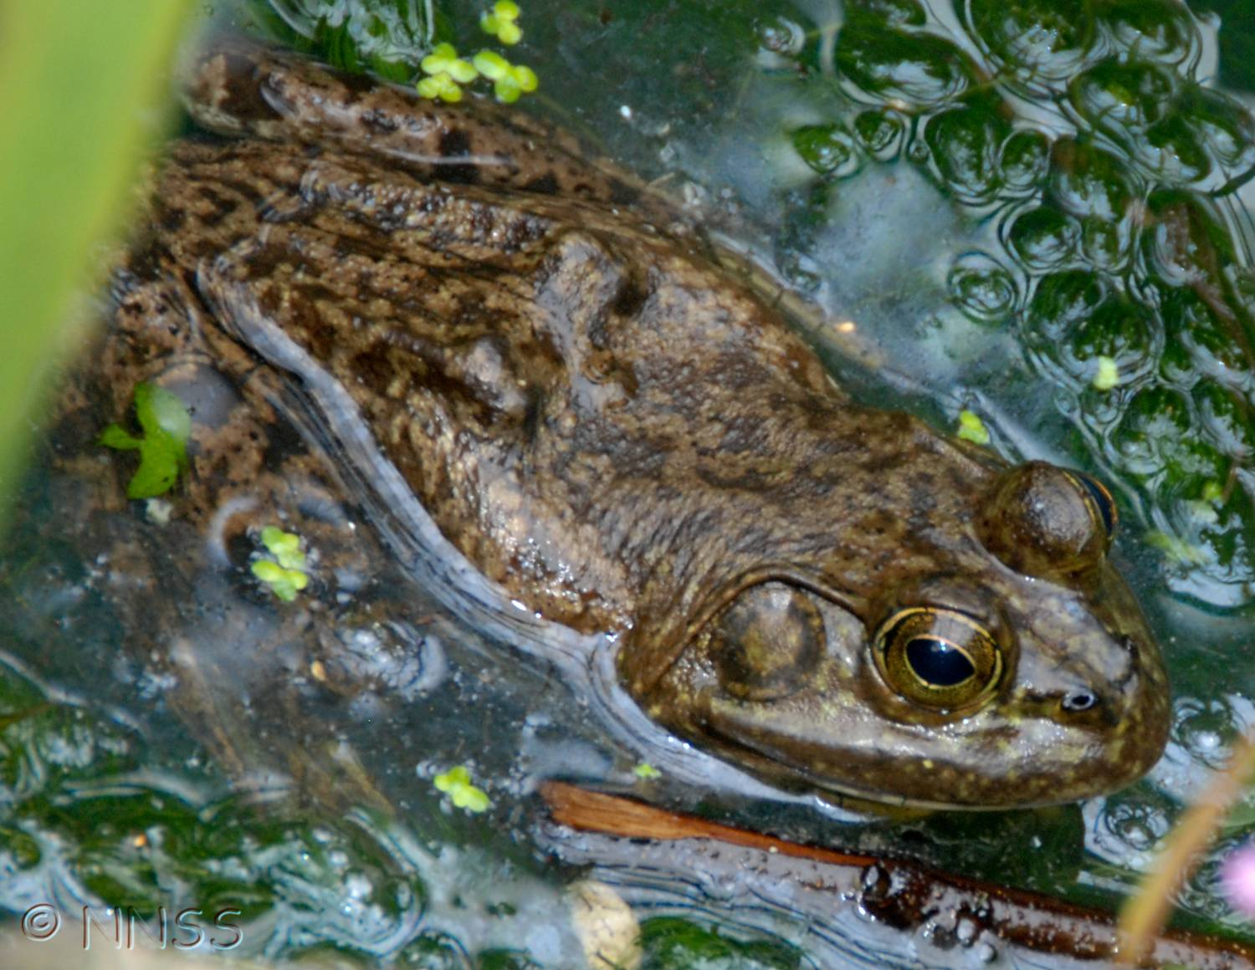
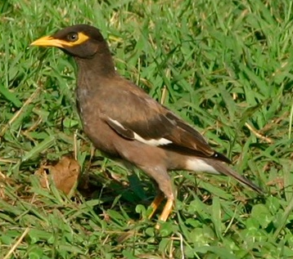
Invasive species 2 – Biodiversity Impacts

Slide 2
Invasive Species 2 – Biodiversity Impacts
Part i
Introduction
Sea birds & fishes
Part ii
Reptiles & amphibians
Part iii
Evolutionary effects
Birds
Mammals
Part iv
Rodents
Conclusions

Slide 3
Invasive Species 2 – Biodiversity Impacts
Module Learning Outcomes:
Knowledge and understanding
1. Demonstrate critical awareness of the rapidly changing status of species in the natural environment, the implications for ecosystem services, and the approaches to addressing these problems in different ecosystems.
Intellectual, practical, affective and transferable skills
3. Critically assess conservation issues and communicate scientific arguments to a wide audience.

Slide 4
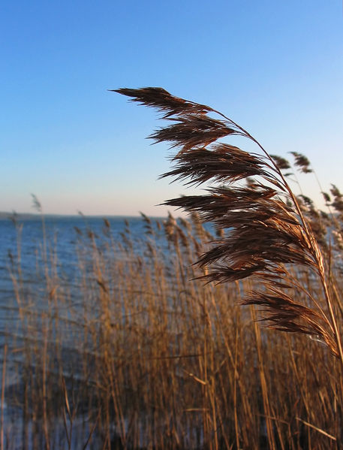
Effects on biodiversity
Predation & parasitism
Competition
Disease vectoring
Hybridisation
Notes:
Image: http://en.wikipedia.org/wiki/File:Phragmites_australis_Schilfrohr.jpg

Slide 5
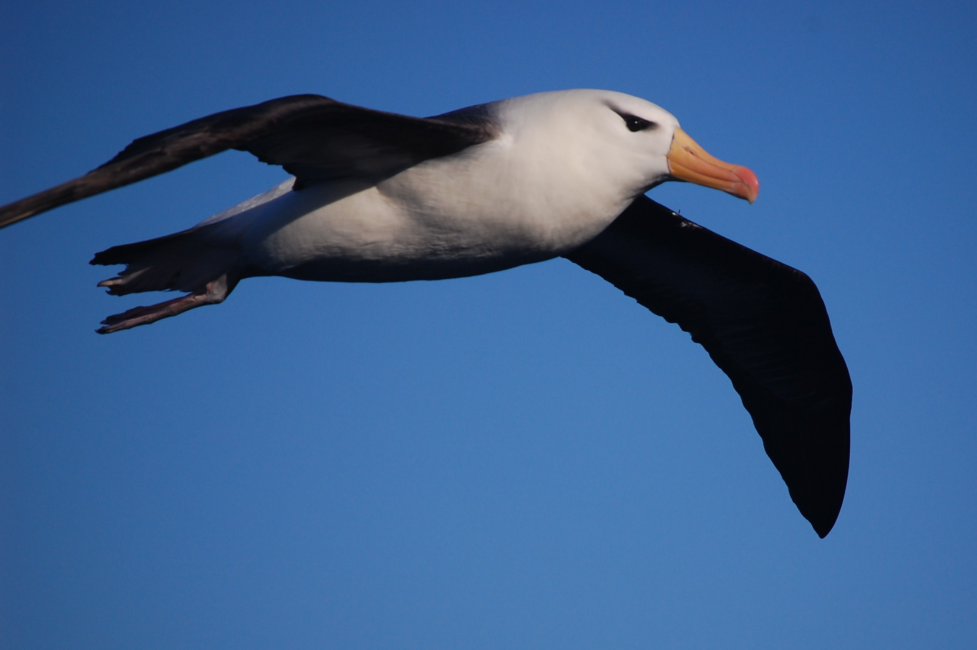
Effects on biodiversity
‘Invasive species (especially predators) threaten nearly a third of Globally Threatened Birds.’ http://www.birdlife.org/action/science/species/global_species_programme/red_list.html
73% (n=104) of seabirds listed by the IUCN are threatened by invasive species (Donlan & Wilcox, 2008)
Black-browed albatross Thalassarche melanophrys Image: Elizabeth Crapo NOAA Photo Library
Notes:
Black-browed albatross Thalassarche melanophrys Image: Elizabeth Crapo NOAA Photo Library

Slide 6
30 of worst 100 global invasive alien species are vertebrates (?)
Source: www.issg.org/database

Slide 7
Fishes
Most diverse vertebrate group ~30,000 species
Aliens tend to dominate in freshwater
Although 20% of Mediterranean fish fauna is exotic
Temperate & arid areas particularly affected
Biotic homogenisation
Many aliens from –
Cyprinidae (carps) - European & Asian origin
Salmonidae (salmon & trout) - Europe
Cichlidae (tilapias & cichlids) - Africa
Gobiidae (gobies) - E. Asia
Poeciliidae (livebearers) - N. America
Centrarchidae (sunfishes) - N. America
Notes:
Source: Moyle & Garcia-Berthou (2011) Fishes. In: Encyc. Biol. Inv.

Slide 8
Invasive Species 2 – Biodiversity Impacts
Part i
Introduction
Sea birds & fishes
Part ii
Reptiles & amphibians
Part iii
Evolutionary effects
Birds
Mammals
Part iv
Rodents
Conclusions

Slide 9
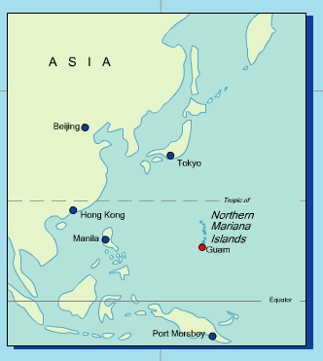
Ecosystem effects: Brown treesnake Boiga irregularis on Guam
Accidental introduction
with military equipment
Native to Australia & Papua New Guinea
Snakes generally regarded as not heavily influencing their prey

Slide 10
Ecosystem effects: Brown treesnake Boiga irregularis on Guam
DIRECT ecological effects
Caused almost total removal of native forest birds
INDIRECT
Removal of fruit-eating birds → loss of pollination & seed-dispersal
Increase in spider abundance
Notes:
Photo: http://en.wikipedia.org/wiki/File:Brown_tree_snake_Boiga_irregularis_2_USGS_Photograph.jpg

Slide 11
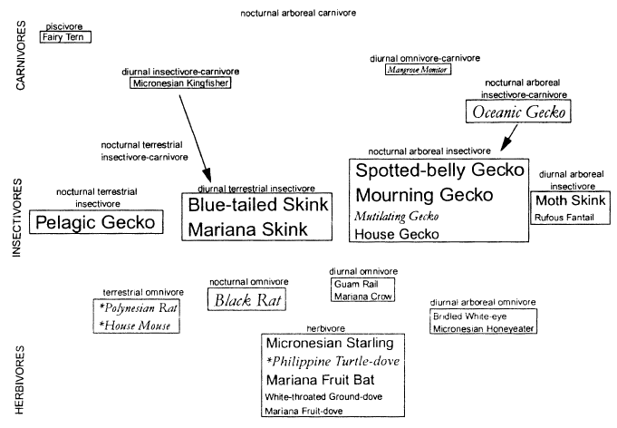
Guam vertebrate foodweb 1945 Italic = introduced species; Font size indicates relative biomass
Notes:
Source: Fritts & Rodda (1998) Ann. Rev. Ecol. Systematics 29: 113-140

Slide 12
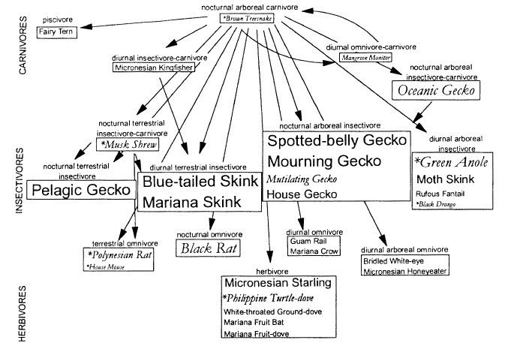
Guam vertebrate foodweb 1965 Italic = introduced species; Font size indicates relative biomass
Notes:
Source: Fritts & Rodda (1998) Ann. Rev. Ecol. Systematics 29: 113-140

Slide 13
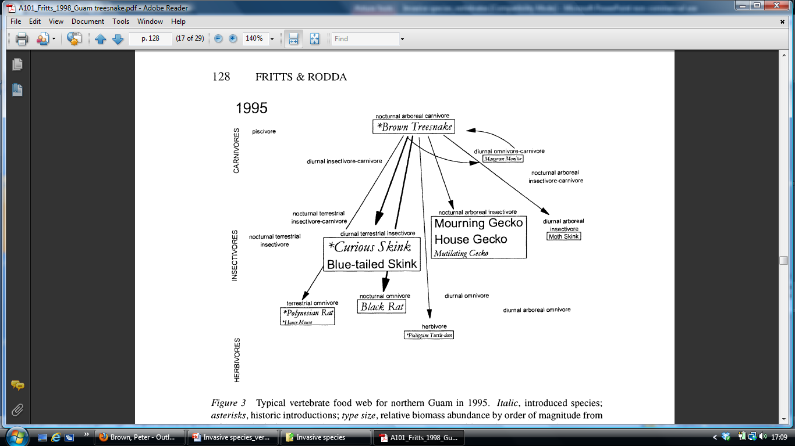
Guam vertebrate foodweb 1995 Italic = introduced species; Font size indicates relative biomass
Notes:
Source: Fritts & Rodda (1998) Ann. Rev. Ecol. Systematics 29: 113-140

Slide 14
Guam vertebrate foodweb 1945 and 1995
1945
Italic = introduced species;
Font size indicates relative biomass;
Crossed-out species = extinct
Source: Fritts & Rodda (1998) Ann. Rev. Ecol. Systematics 29: 113-140
1995
Notes:
Source: Fritts & Rodda (1998) Ann. Rev. Ecol. Systematics 29: 113-140

Slide 15
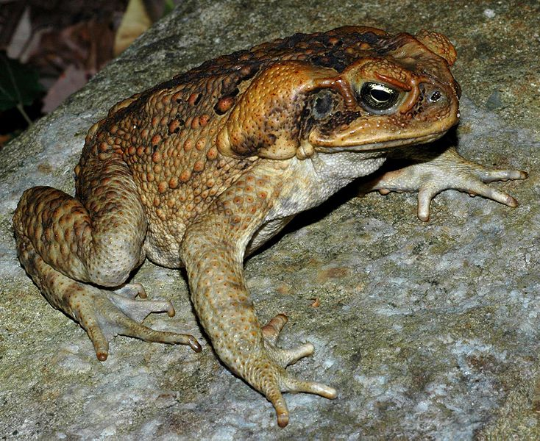
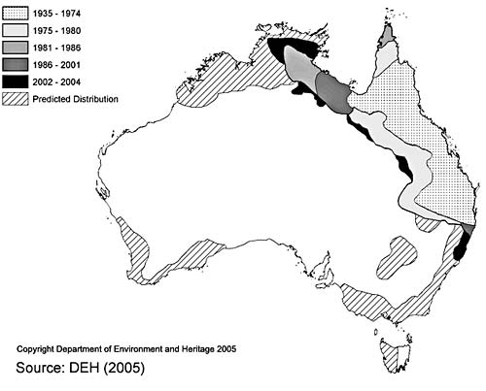
Impacts - Ecological
Few herptile invasions investigated
Disruption of food webs
predation, competition (food, shelter), poisoning
e.g. cane toad Rhinella marina
Australia - to control sugar cane pest (1935)
toads & tadpoles toxic
Notes:
Source: Kraus (2011) Reptiles and amphibians. In: Encyc. Biol. Inv. P591
Map: http://www.environment.gov.au/soe/2006/publications/drs/indicator/208/index.html
Cane toad photo: http://en.wikipedia.org/wiki/File:Bufo_marinus_from_Australia.JPG

Slide 16
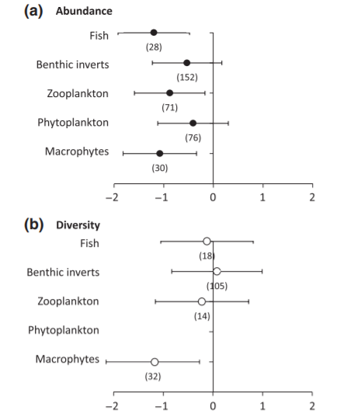
Summary of impacts in aquatic ecosystems
Fig. 1 Overall effects of invasive species on the abundance (a) and diversity (b) of five different functional groups of aquatic ecosystems
Source: Gallardo et al., 2016. Global Change Biology 22: 151-163.
Notes:
Fig. 1 Overall effects of invasive species on the abundance (a) and diversity (b) of five different functional groups of aquatic ecosystems and four environmental characteristics (c). In parentheses, the number of effect sizes considered in each case. Error bars represent 95% confidence intervals and are only displayed when the number of effect sizes analysed was ≥5. A significant effect of invasion is found when error bars do not overlap zero.
From Gallardo, B., Clavero, M., Sánchez, M.I. and Vilà, M., 2016. Global ecological impacts of invasive species in aquatic ecosystems. Global change biology, 22(1), pp.151-163.

Slide 17
Invasive Species 2 – Biodiversity Impacts
Part i
Introduction
Sea birds & fishes
Part ii
Reptiles & amphibians
Part iii
Evolutionary effects
Birds
Mammals
Part iv
Rodents
Conclusions

Slide 18
Some effects of aliens are more subtle...

Slide 19
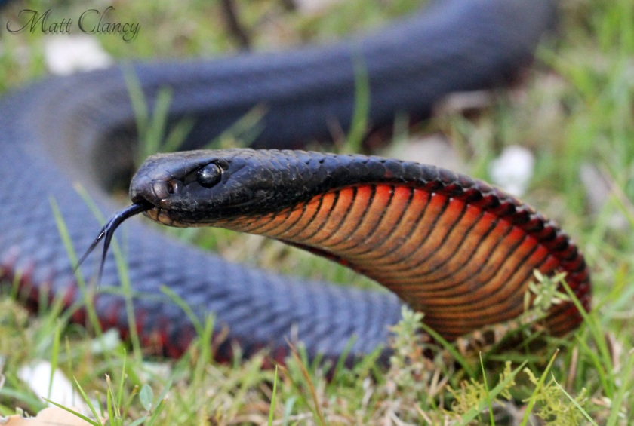
Impacts - Evolutionary
Cane toad in Australia – evolutionary changes to native snake predators, e.g. red-bellied black snake Pseudechis porphyriacus
morphology – evolved relatively smaller gape & rel. larger body size
behaviour – evolved greater aversion to eating toads
physiology – evolved greater resistance to toad toxins
Notes:
Source: Kraus (2011) Reptiles and amphibians. In: Encyc. Biol. Inv. P592
Image: http://commons.wikimedia.org/wiki/File:Red-bellied_Black_Snake_%28Pseudechis_porphyriacus%29_%288397137495%29.jpg

Slide 20
Impacts - Evolutionary
Hybridization
Most widely reported impact from herptiles
e.g. native California tiger salamander and alien congeners
Reeds – native & invasive Phragmites species (Meyerson et al, 2010 Biol. Invasions 12: 103-111)
Deer – Red Cervus elaphus & Sika C. nippon (Goodman et al, 1999 Genetics 152: 355-371; Perez-Espona et al, 2009 Mammalian Biology 74: 247-262)
Notes:
Image: http://en.wikipedia.org/wiki/File:Phragmites_australis_Schilfrohr.jpg

Slide 21
Alien birds
Globally - 1400 attempts to introduce 400 bird species (70% to islands) – mostly in 18th/19thC
Main reasons – hunting, aesthetics, biocontrol
Two thirds of alien species are from just 6 (of 145) families –
Anatidae (ducks), Phasianidae (pheasants)
Fringillidae (finches), Passeridae (sparrows), Psittacidae (parrots), Columbidae (pigeons & doves)
Logging, grazing & agriculture aided invasions by creating suitable habitats
Notes:
Source: Sodhi (2011) Birds. In: Encyc. Biol. Inv.

Slide 22
Common myna in Australia
1860s – introduced in Melbourne market gardens for insect control
Now the predominant bird in some urban areas
Cairns – approx. 1000 per sq km
Released again in 1960s, to Canberra
12 birds → 150,000 by 2007
Hole-nester
outcompetes native birds & arboreal mammals
predator
Human nuisance
Common myna Acridotheres tristis
Notes:
Photo: http://dx.doi.org/10.1371/journal.pbio.0040279

Slide 23
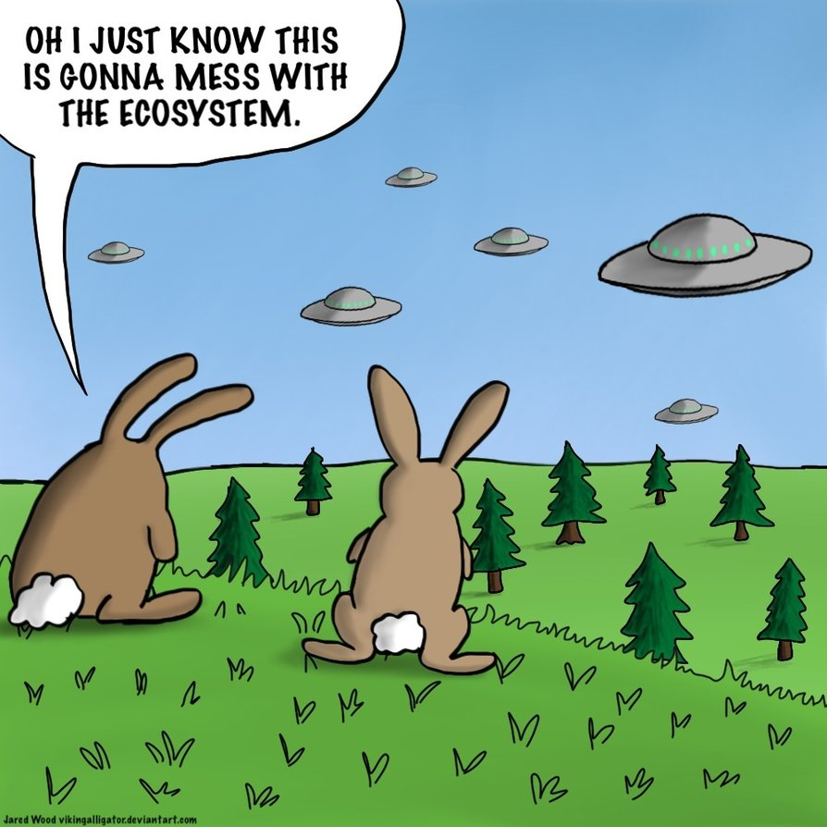
Mammals
Especially damaging on islands
Goats
Pigs
Dogs
Cats
Rodents
Notes:
http://vikingalligator.deviantart.com/art/Invasive-Species-365887870

Slide 24
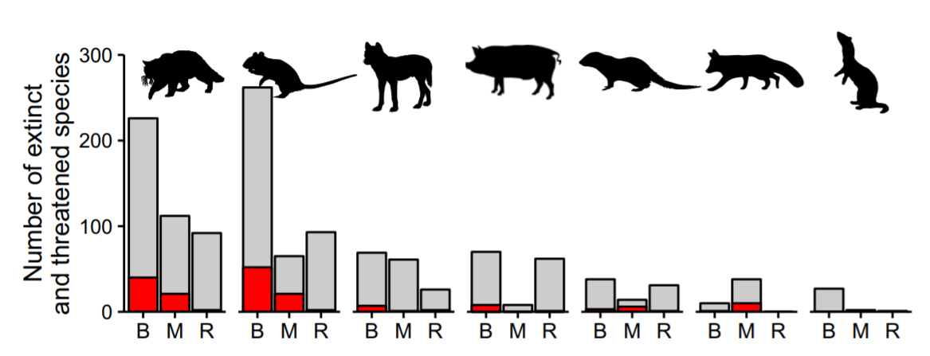
Fig. 2. Numbers of threatened and extinct bird (B), mammal (M), and reptile (R) species negatively affected by invasive mammalian predators.
Grey bars: total number of extinct and threatened species
Red bars: extinct species
Predators affecting <15 species are not shown here. Predators (L to R) are the cat, rodents, dog, pig, small Indian mongoose, red fox, and stoat.
Source: Doherty et al., 2016. PNAS 113: 11261-11265.
Notes:
Doherty, T.S., Glen, A.S., Nimmo, D.G., Ritchie, E.G. and Dickman, C.R., 2016. Invasive predators and global biodiversity loss. Proceedings of the National Academy of Sciences, 113(40), pp.11261-11265.

Slide 25
Invasive Species 2 – Biodiversity Impacts
Part i
Introduction
Sea birds & fishes
Part ii
Reptiles & amphibians
Part iii
Evolutionary effects
Birds
Mammals
Part iv
Rodents
Conclusions

Slide 26
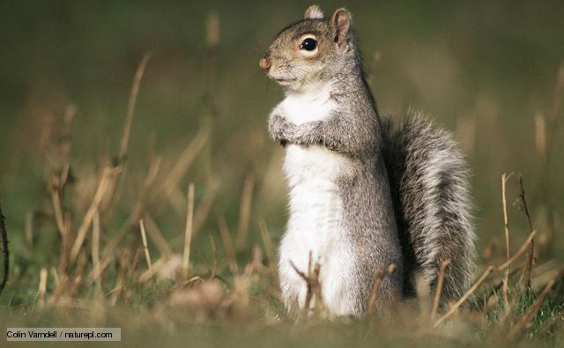
Rodents
Squirrels
Coypu
Notes:
26

Slide 27
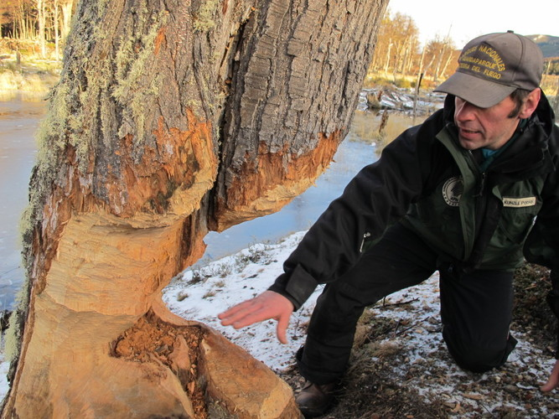
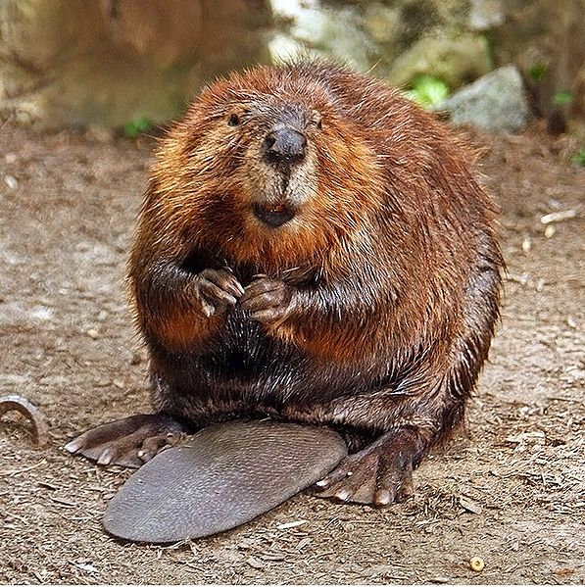
N. American beaver Castor canadensis
Ecosystem engineers – damming & foraging modifies riparian & stream habitats
Introduction to Argentina (1946) & spread into Chile
Causes extensive riparian deforestation & modified watershed
Tree damage in Tierra del Fuego National Park, Argentina
Photo: Juan Forero / NPR
Notes:
Source: Anderson & Valenzuela (2011) Mammals, Aquatic. In: Encyc. Biol. Inv.
Beaver image: http://en.wikipedia.org/wiki/File:American_Beaver.jpg

Slide 28
Rodents
Mice
House mouse (Mus musculus)
stored food pest / disease / household nuisance
ecological effects less well known (co-occurs with rats)
Voles
e.g. bank vole UK to Ireland; common vole UK to Orkney
major effects not detected
Five key rat species introduced over last 10,000 years
Black rat (Rattus rattus), Brown rat (R. norvegicus), Oriental house rat (R. tanezumi), Large spiny rat (R. praetor), Pacific rat (R. exulans)
Notes:
28

Slide 29
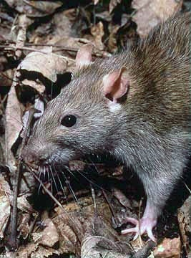
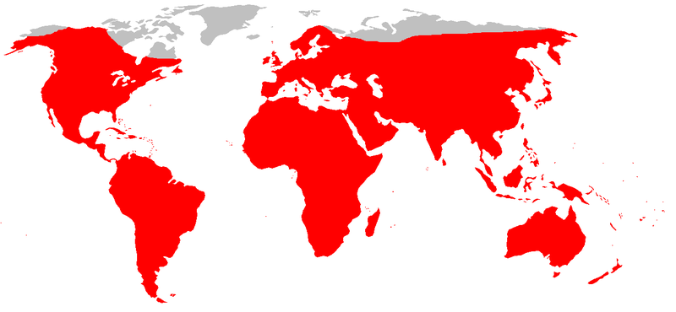
Brown rat (Rattus norvegicus)
Native to SE Siberia, N China, N Japan
18th C invader of W Europe
then spread globally from European ports
thrives in anthropogenic habitats
poor climber but well adapted to water
preys heavily on marine & land birds

Slide 30
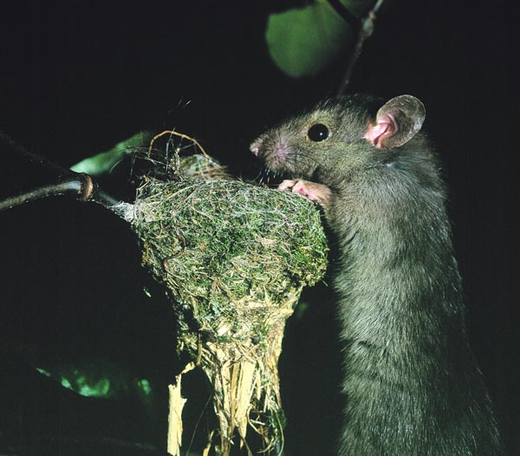
Black rat (Rattus rattus)
Native to Indian subcontinent
Introduced to over 80% of all island groups over last 5000 years
Commensal with humans
did start of agriculture lead to evolution of commensalism in R. rattus?
Black rat approaching NZ fantail nest
Photo: David Mudge
Notes:
From http://www.issg.org/database/species/ecology.asp?si=19&fr=1&sts=sss&lang=EN

Slide 31
Three approaches to assessing impacts of invasive species
By comparing ecosystem status
before and after invasion
on both invaded and non-invaded islands
before and after eradication

Slide 32
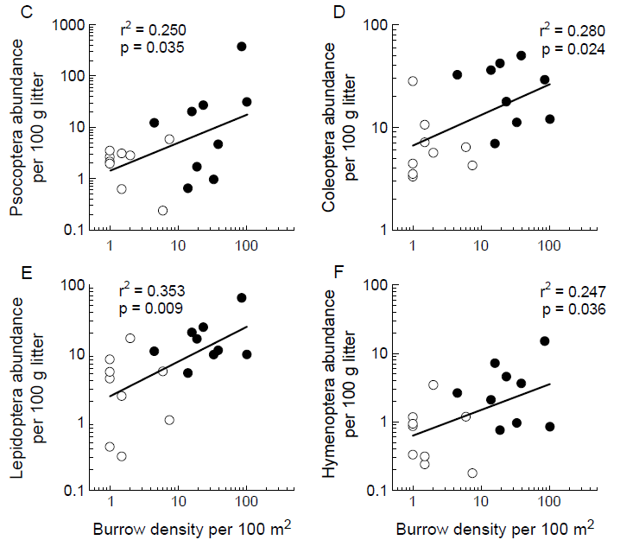
Indirect effects of rat invasion
Rats reducing seabird burrow density: knock-on effects on 8 of 19 invertebrate orders
Uninvaded islands – filled symbols; invaded islands - empty symbols.
Source: Towns et al (2009) Oikos 118: 420-430
Notes:
Source: Towns et al (2009) Oikos 118: 420-430

Slide 33
Impacts of alien species (England)
Economic impact
Environmental impact
No. species
Mostly animals
Mostly plants
Mostly plants
Equally plants & animals
Source: Hill et al., 2005 (English Nature audit)

Slide 34
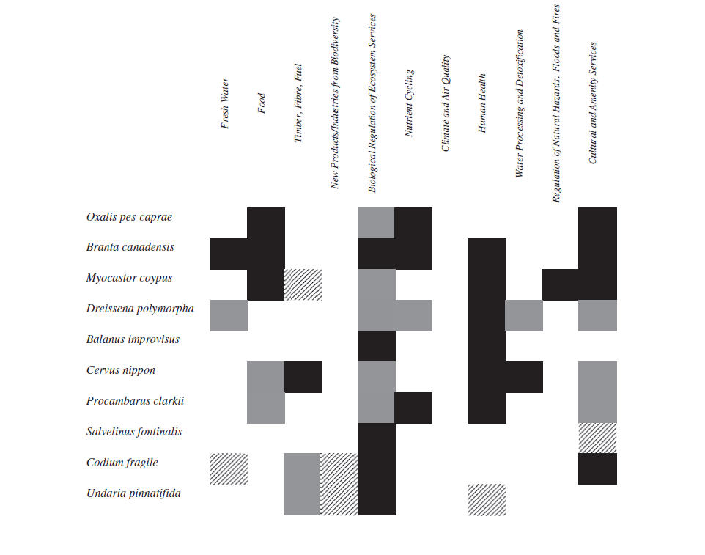
BUT, even some of the ‘worst’ aliens may have mixed or positive effects.
Negative only
Mixed
Positive only
McLaughlan et al., 2014.
Acta Oecologica 54: 119-130.
Notes:
McLaughlan et al. (2014) How complete is our knowledge of the ecosystem services impacts of Europe’s top 10 invasive species?
Acta Oecologica 54: 119-130
Table 2
Summary of the impacts of the 10 worst invasive species on ecosystem services according to the literature available for each species. Dark grey denotes negative impacts only.
Light grey reflects mixed positive and negative impacts. The diagonal patterning is used when only positive impacts are reported in the literature.

Slide 35
Invasive Species 2 – Biodiversity Impacts
Part i
Introduction
Sea birds & fishes
Part ii
Reptiles & amphibians
Part iii
Evolutionary effects
Birds
Mammals
Part iv
Rodents
Conclusions

Slide 36
References
Doherty, T.S., Glen, A.S., Nimmo, D.G., Ritchie, E.G. and Dickman, C.R., 2016. Invasive predators and global biodiversity loss. Proceedings of the National Academy of Sciences 113(40): 11261-11265.
Gallardo, B., Clavero, M., Sánchez, M.I. and Vilà, M., 2016. Global ecological impacts of invasive species in aquatic ecosystems. Global Change Biology 22(1): 151-163.
McLaughlan, C., Gallardo, B. and Aldridge, D.C., 2014. How complete is our knowledge of the ecosystem services impacts of Europe’s top 10 invasive species? Acta Oecologica 54: 119-130.
Simberloff, D. & Rejmǹek, M. (eds), 2011. Encyclopedia of biological invasions. Berkeley: University of California Press.

